Slide 1
Chapter 16 – Object Localization and Detection

Slide 2
In This Chapter
Object localization and detection
Landmark detection
Evaluating Object Localization and Detection
Intersection over union
Convolutional sliding window
YOLO and SDD
Non-max suppression

Slide 3
Object Localization and Detection

Slide 4
Object Localization, Classification, and Detection
Object localization, classification, and detection are among the most important tasks in computer vision.
Object localization is the task to find the locations of the objects in the image or in video.
Object classification is the task to classify to what classes or instances the identified object or objects belong.
Object detection is a complex task to localize and an object or multiple objects in the image or video.

Slide 5
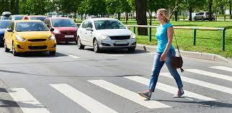
Object Localization
Object localization is the process of identifying the location of an object in an image or video.
It is a common task in the field of computer vision and is used in a wide range of applications including image and video analysis, object tracking, and augmented reality being developed to improve the accuracy and effectiveness of object localization algorithms.
Object localization is an important task in computer vision, as it allows computers to recognize and understand the content of an image or video.
The positions of the objects were found in the image

Slide 6
Object Classification
The goal of object classification is to determine the class of each feature, such as a building.
For example, you can use it to determine
if an object is a car
If an object is a pedestrian
if an object is a cat or a dog
and many other tasks
The objects were classified:
- car
- pedestrian
- crosswalk

Slide 7
Object Detection
Object detection task should identify that there is an object or are multiple objects in the image or video including their localization and classification.
A variety of different objects were detected in the image including their localization and classification.

Slide 8
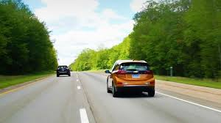
Object Classification, Localization, and Detection
Object Classification
Detection: localization + classification
Localization
(x,y)
(x,y)
(width, height)
(width, height)
Object position (upper-left corner)
Forest Forest Forest
Forest Forest Forest
Car
Car
Car
Car
Each object position in the image
Each object is classified
Multiple objects are detected

Slide 9
Object Detection and Tracking
There are several approaches that can be used for object localization, including
object detection algorithms and
object tracking algorithms.
Object detection algorithms are designed to identify and locate objects in an image or video and can be based on techniques such as feature extraction and classification.
Object tracking algorithms are designed to follow the movement of an object over time and can be based on techniques such as Kalman filters and particle filters.
https://encord.com/glossary/object-localization-definition/

Slide 10
Occlusion, Backdrop Clutter, and Object Variability
Occlusion, backdrop clutter, and object variability are a few of the difficulties in object localization.
Occlusion happens when a portion of an object is obscured by another object, making it challenging to find the object with accuracy.
Background clutter refers to the situation when there are additional items or features in an image that can make it difficult to localize the target object.
Object variability (in object appearance) describes how the same thing might appear differently in several photos or films depending on the lighting, position, and viewpoint.

Slide 11
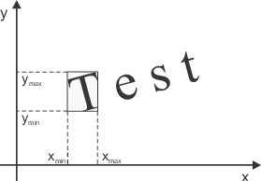
Bounding Box
A bounding box is a rectangular coordinate system used to define a geometric area on an image.
Coordinates of a bounding box are encoded with four values in pixels: [x_min, y_min, x_max, y_max] .
x_min and y_min are coordinates of the top-left corner of the bounding box.
x_max and y_max are coordinates of bottom-right corner of the bounding box.

Slide 12
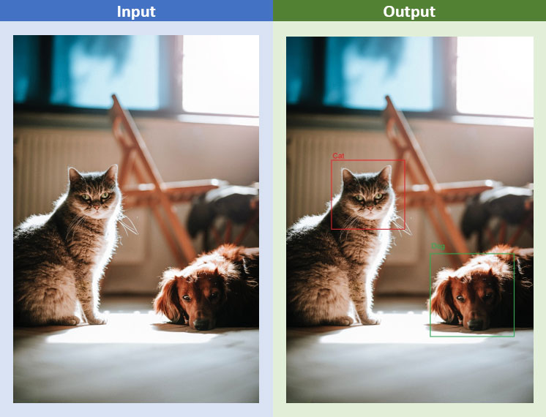
Object Detection Input/Output
Obj-1:
cat,
x1_min, y1_min, x1_max, y1_max
Obj-2:
x2_min, y2_min, x2_max, y2_max
Image/Object localization is a regression problem where the output is x and y coordinates around the object of interest to draw bounding boxes.
Input: an image
Output: x_min, y_min, x_max, y_max, of an object of interest
Object detection is a complex problem that combines image localization and classification.
Given an image, an object detection algorithm would return bounding boxes around all objects of interest and assign a class to them.
https://www.einfochips.com/blog/understanding-object-localization-with-deep-learning/

Slide 13
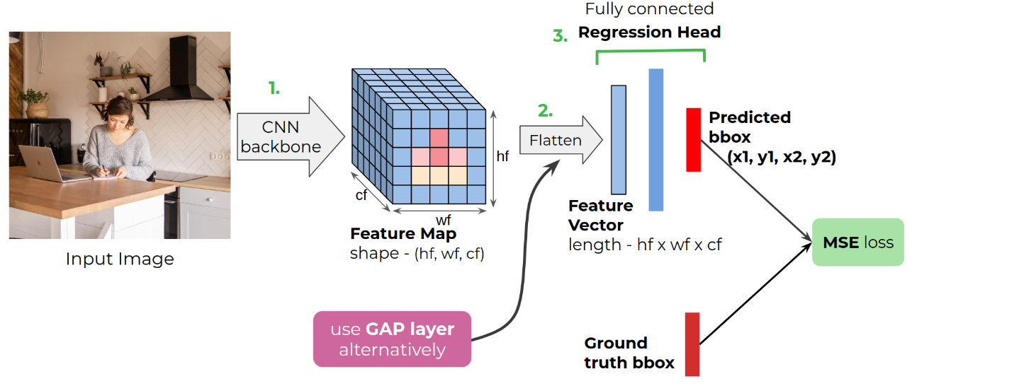
Object Localization Techniques
Image localization could be done with regular CNN vision algorithms.
These algorithms predict classes with discrete numbers.
In object localization, the algorithm predicts a set of 4 numbers, namely, x_min, y_min, x_max, and y_max to draw a bounding box around an object of interest.
https://www.einfochips.com/blog/understanding-object-localization-with-deep-learning/

Slide 14
Object Localization Techniques with CNN
In CNN-based classifiers, initial layers are convolutional neural network layers ranging from a couple of layers to 100 layers (e.g., ResNet 101), and that depends on the application, amount of data, and computational resources available.
The number of layers is itself a large area of research.
After the CNN layers, there are a pooling layer and then one or two fully connected layers.
The last layer is the output layer which gives a probability of an object being present in an image.
For example, suppose an algorithm identifies 100 different objects in a given image. Then, the last layer gives an array length of 100 and values ranging from 0 to 1 that denote the probability of an object being present in an image.

Slide 15
Object Localization Techniques – Bounding Boxes
In an image localization algorithm, everything is the same except the output layer.
In classification algorithms, the final layer gives a probability value ranging from 0 to 1.
In contrast, localization algorithms give an output in four real numbers, as localization is a regression problem.
As discussed above, those four values – x and y of the upper-left corner and width and height of the bounding box – are used to draw a box around the object.

Slide 16
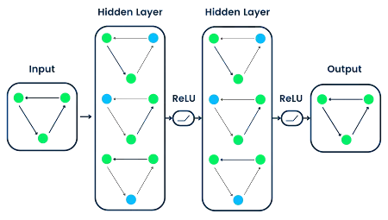
Graph Neural Networks (GNNs)
Graph Neural Networks (GNNs) are a class of deep learning models designed to process and analyze graph-structured data.
GNNs leverage the inherent structural information of graphs to learn powerful node and graph representations, enabling them to capture complex dependencies and propagate information effectively across the graph

Slide 17
Graph Neural Networks (GNNs)
GNNs will play an instrumental role in multi-object localization tasks.
Ground truth boxes are manually labeled bounding boxes for training GNN.
By modeling relationships between objects and their context, GNNs enable more accurate and context-aware object localization in cluttered environments.

Slide 18
Classification with Localization
0 – no object
1 – pedestrian
2 – car
3 – motorcycle
4 – crosswalk
Bounding box coordinates
softmax
Bounding box (x_min, y_min,
x_max y_max)
…
…
…
…
(2 ; P1, x1_min, y1_min, x1_max, y1_max)
(1 ; P2, x2_min, y2_min, x2_max, y2_max)
(4 ; P3, x3 _min, y3_min, x3_max, y3_max)

Slide 19
Defining the Target Label – Boolean Classifier
Object classifier
0 – no object
1 – pedestrian
2 – car
3 – motorcycle
4 – crosswalk
Format of the object label vector:
Pc = {0,1} -> Object is/not detected
x of the upper-left corner
y of the upper-left corner
x of the bottom-right corner
y of the bottom-right corner
c1 = {0,1} it is a pedestrian
c1 = {0,1} it is a car
c1 = {0,1} it is a motorcycle
c1 = {0,1} it is a crosswalk
1
15
22
46
47
0
1
0
0
Object is here
x of the upper-left corner
y of the upper-left corner
x of the bottom-right corner
y of the bottom-right corner
not a pedestrian
a car
not a motorcycle
not a crosswalk
Pc
X_min
y_min
x_max
y_max
c1
c2
c3
c4

Slide 20
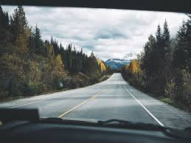
Defining the Target Label – Boolean Classifier
Object classifier
0 – no object
1 – pedestrian
2 – car
3 – motorcycle
4 – crosswalk
Format of the object label vector:
Pc = {0,1} -> Object is/not detected
x of the upper-left corner
y of the upper-left corner
x of the bottom-right corner
y of the bottom-right corner
c₁ = {0,1} it is a pedestrian
c₂ = {0,1} it is a car
c₃ = {0,1} it is a motorcycle
c₄ = {0,1} it is a crosswalk
0
?
?
?
?
?
?
?
?
Object is not here
No x for upper-left corner
No y for upper-left corner
No width
No height
Not classified
Not classified
Not classified
Not classified
Pc
x_min
y_min
x_max
y_max
c₁
c₂
c₃
c₄

Slide 21
Loss Function for Localization – Boolean Classifier
Object classifier
0 – no object
1 – pedestrian
2 – car
3 – motorcycle
4 – crosswalk
Label Output
Y
y₁ y₂
y₃ y₄
y₅ y₆
y₇ y₈
y₉
A
a₁ a₂
a₃ a₄
a₅ a₆
a₇ a₈
a₉
J(A,Y) = (a₁ - y₁)² + (a₂ - y₂)² + (a₃ - y₃)² +
(a₄ - y₄)² +
(a₅ - y₅)² +
(a₆ - y₆)² +
(a₇ - y₇)² +
(a₈ - y₈)² +
(a₉ - y₉)²
Format of the object label vector:
Pc
x_min
y_min
x_max
y_max
c₁
c₂
c₃
c₄
Pc = {0,1} -> Object is/not detected
x of the upper-left corner
y of the upper-left corner
x of the bottom-right corner
y of the bottom-right corner
c₁ = {0,1} it is a pedestrian
c₂ = {0,1} it is a car
c₃ = {0,1} it is a motorcycle
c₄ = {0,1} it is a crosswalk

Slide 22
Defining the Target Label – Softmax Classifier
Object classifier
0 – no object
1 – pedestrian
2 – car
3 – motorcycle
4 – crosswalk
(0,0)
(0,1)
(1,0)
(1,1)
Image can be represented in the normalized coordinates (0,0) - (1,1)
Format of the object label vector:
Pc
x_min
y_min
x_max
y_max
c
Pc = {0,1} -> Object is/not detected
x of the upper-left corner
y of the upper-left corner
x of the bottom-right corner
y of the bottom-right corner
c -> object classification number
1
.15
.2
.6
.5
2
Object is here
x of the upper-left corner
y of the upper-left corner
width
height
a car

Slide 23
Defining the Target Label – Softmax Classifier
Object classifier
0 – no object
1 – pedestrian
2 – car
3 – motorcycle
4 – crosswalk
(0,0)
(0,1)
(1,0)
(1,1)
Format of the object label vector:
Pc
x_min
y_min
x_max
y_max
c
Pc = {0,1} -> Object is/not detected
x of the upper-left corner
y of the upper-left corner
x of the bottom-right corner
y of the bottom-right corner
c -> object classification number
1
.15
.2
.6
.5
2
Object is here
x of the upper-left corner
y of the upper-left corner
width
height
a car

Slide 24
Loss Function for Localization – Softmax Classifier
Object classifier
0 – no object
1 – pedestrian
2 – car
3 – motorcycle
4 – crosswalk
Label Output
Y
y₁ y₂
y₃ y₄
y₅ y₆
A
a₁ a₂
a₃ a₄
a₅ a₆
J(A,Y) = (a₁ - y₁)² + (a₂ - y₂)² + (a₃ - y₃)² +
(a₄ - y₄)² +
(a₅ - y₅)² +
F(a₆, y₆)
Format of the object label vector:
Pc
X_min
y_min
x_max
y_max
c
Pc = {0,1} -> Object is/not detected
x of the upper-left corner
y of the upper-left corner
x of the bottom-right corner
y of the bottom-right corner
c -> object classification number

Slide 25
Landmark Detection

Slide 26
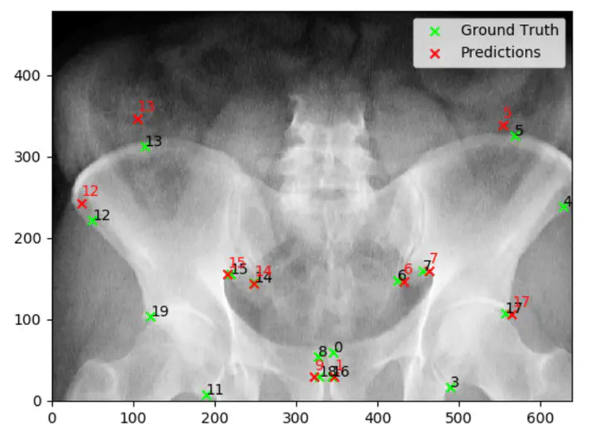
Landmark Detection
In computer science, landmark detection is the process of finding significant landmarks in an image.
This originally referred to finding landmarks for navigational purposes – for instance, in robot vision or creating maps from satellite images.
Methods used in navigation have been extended to other fields, notably in facial recognition where it is used to identify key points on a face.
It also has important applications in medicine, identifying anatomical landmarks in medical images.

Slide 27
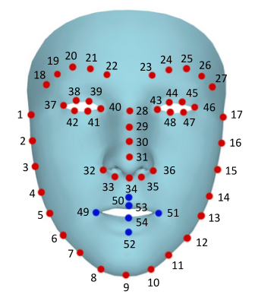
Facial Landmark Detection
Finding facial landmarks is an important step in facial identification of people in an image.
Facial landmarks can also be used to extract information about mood and intention of the person.
Methods used fall in to three categories: holistic methods, constrained local model methods, and regression-based methods.

Slide 28
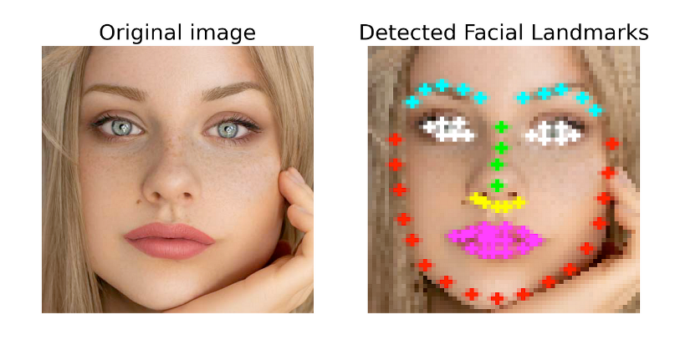

Facial Landmark Detection with CNN
Convolutional Neural Network
Features detection by layers
Face?
x1
y1
…
xN
yN
…
…
…
…

Slide 29
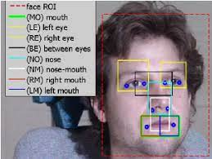
Variety of Landmarks in Face Recognition

Slide 30
Evaluating Object Localization and Detection
Intersection Over Union

Slide 31
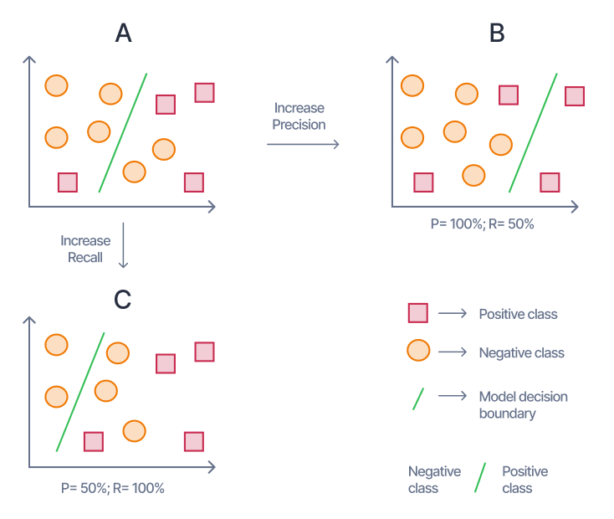
Evaluating Object Localization
How do you evaluate object localization model?
Evaluation Metrics: Object localization models are evaluated using metrics such as Intersection over Union (IoU) and Mean Average Precision (mAP), which provide quantitative measures of the accuracy and robustness of the localization process.

Slide 32
Intersection over Union (IoU)
Intersection over Union (IoU) is a measure that shows how well the prediction bounding box aligns with the ground truth box.
It's one of the main metrics for evaluating the accuracy of object detection algorithms and helps distinguish between "correct detection" and "incorrect detection".
Object
Area of Overlap (Intersection)
Area of Union
Detected box
IoU =
Object
Detected box

Slide 33
Understanding IoU
Intersection over union is actually a very straightforward and self-explanatory measurement and is based on the Jaccard index (a coefficient for similarity for two sets of data).
Given the two bounding boxes – the predicted and ground truth ones and their areas, calculating IoU becomes a piece of cake.
It may appear at first that IoU is an indicator of how tight the bounding box is, which, as much as we hate to break it to you, is not quite the truth.
What the IoU shows instead is how tight the predicted bounding boxes are to the baseline, i.e., the ground truth.
Now, what Intersection over Union (IoU) does is it calculates the overlap of the two bounding boxes divided by their union to provide an accuracy metric.

Slide 34
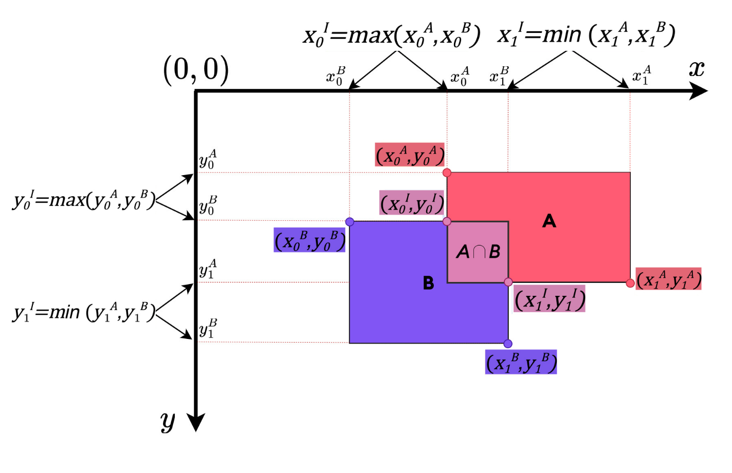
IoU Calculation

Slide 35
Example of the Localization Evaluation
Correct if IoU ≥ 0.5

Slide 36
Mean Average Precision (mAP)
Mean Average Precision (mAP) is a metric used to measure the performance of a model for tasks such as object detection tasks and information retrieval.
mAP leverages these sub-metrics: Confused Matrix, Intersection over Union (IoU), Recall, and Precision.
Precision can be seen as a measure of quality.
Recall as a measure of quantity. Higher precision means that an algorithm returns more relevant results than irrelevant ones, and high recall means that an algorithm returns most of the relevant results (whether or not irrelevant ones are also returned).

Slide 37
Convolutional Sliding Window

Slide 38
Sliding Windows Method
The sliding window technique is a method for iterating over a sequence of data, typically used in the context of machine learning and image processing.
It involves dividing the data into overlapping windows of a fixed size and processing each window independently.

Slide 39
Sliding Windows Method
The sliding window may vary to capture objects of different sizes.
The overlapping windows help detect whole objects rather than their fractions.
…

Slide 40
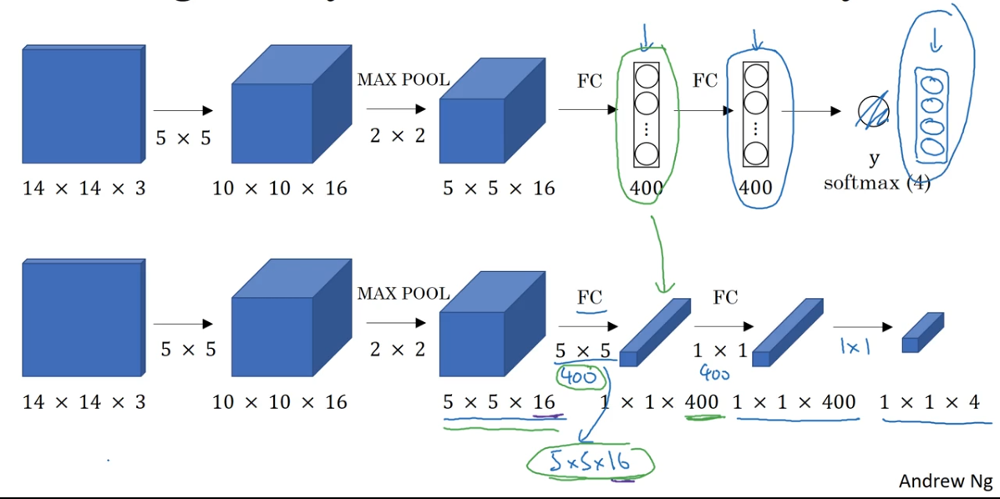
Turning FC Layer Into Convolutional Layers

Slide 41
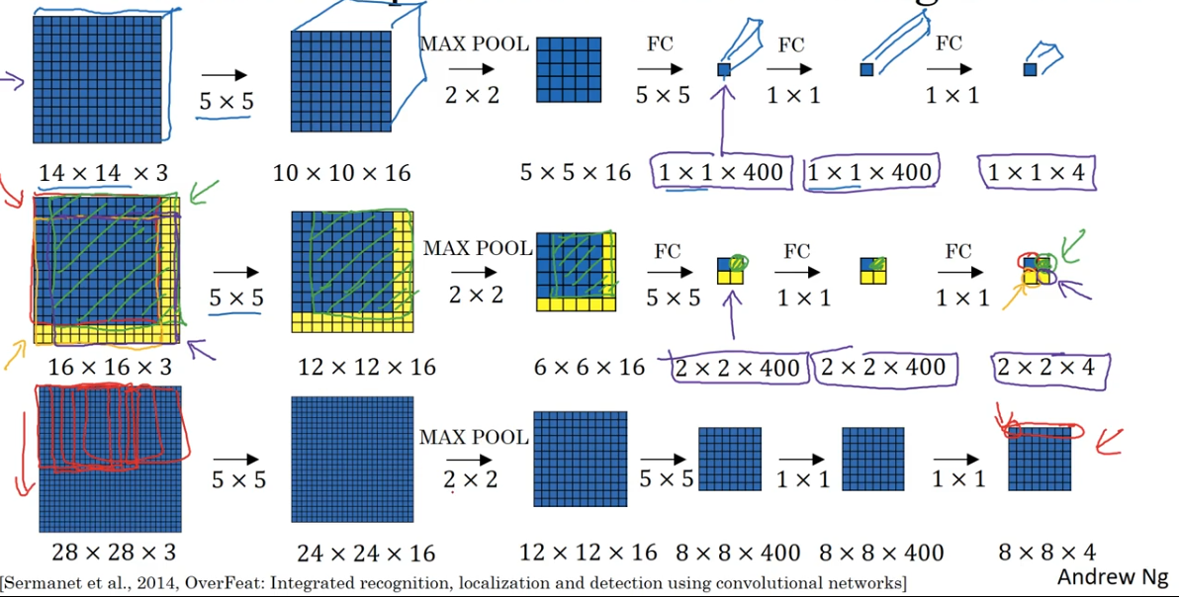
Convolutional Implementation of Sliding Windows

Slide 42
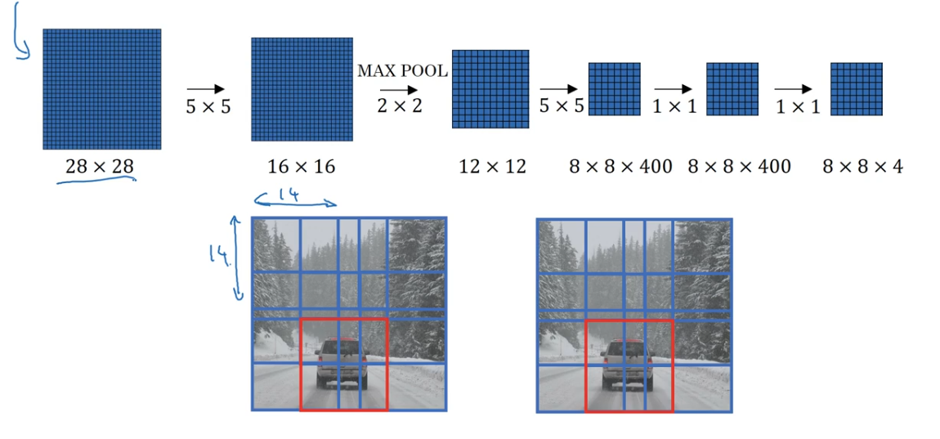
Convolutional Implementation of Sliding Windows

Slide 43
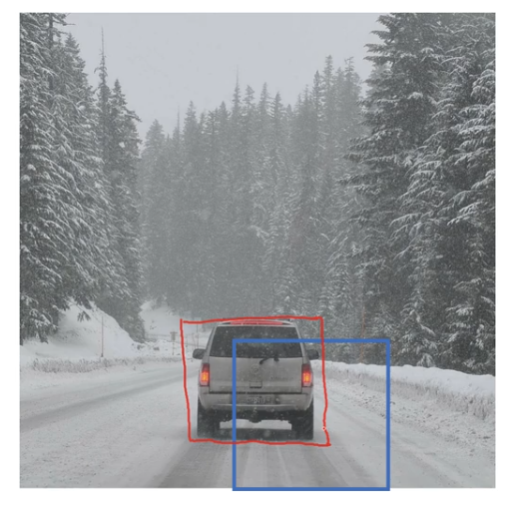
Obtaining Accurate Bounding Boxes
In result of
gradually reducing the sliding window size and detecting objects in them
using pixels as the grid size or gradually reducing the grid size,
accurate bounding boxes around the detected objects appear.

Slide 44
Weaknesses of Sliding Window Approach (1/2)
It's natural to think of building an object detection model on the top of an image classification model.
Once we have a good image classifier, a simple way to detect objects is to slide a 'window' across the image and classify whether the image in that window (cropped out region of the image) is of the desired type.

Slide 45
Weaknesses of Sliding Window Approach (2/2)
Sounds simple! Well, there are at least two problems:
Problem 1
How do you know the size of the window so that it always contains the object?
Different types of objects (palm tree and swimming pool), even the same type of objects (e.g. a small building and a large building) can be of varying sizes as well.
Problem 2
Aspect ratio (the ratio of height to width of a bounding box).
A lot of objects can be present in various shapes like a building footprint will have a different aspect ratio than a palm tree.
To solve these problems, we would have to try out different sizes/shapes of sliding window, which is very computationally intensive, especially with deep neural network (see next slide).

Slide 46
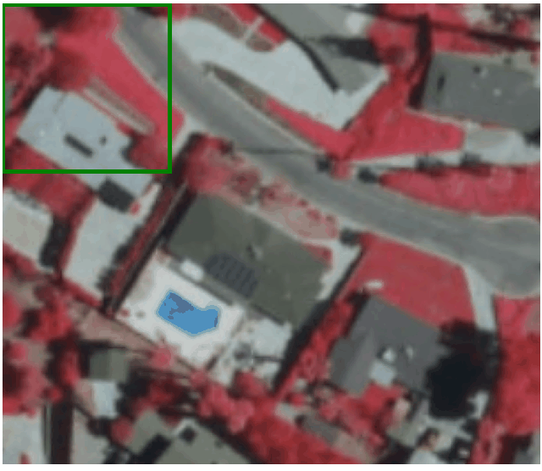
Sliding Windows of Different Sizes/Shapes

Slide 47
YOLO and SSD Algorithms

Slide 48
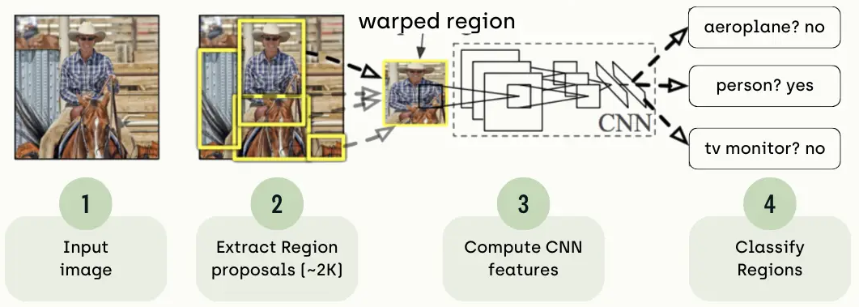
Region-based Convolutional Neural Network (R-CNN)
Region-based Convolutional Neural Network (R-CNN) is a type of deep learning architecture used for object detection in computer vision tasks.
R-CNN was one of the pioneering models that helped advance the object detection field by combining the power of convolutional neural networks and region-based approaches.

Slide 49
YOLO Algorithm
YOLO (You Only Look Once) is a real-time object detection algorithm developed by Joseph Redmon and Ali Farhadi in 2015.
Single-shot object detection is a type of object detection algorithm that is able to detect objects within an image or video in a single pass without the need for multiple stages or region proposals.
Single-shot object detectors, such as YOLO (You Only Look Once) and SSD (Single Shot MultiBox Detector), use a single convolutional neural network (CNN) to directly predict the class labels and bounding boxes of objects within an image or video.
These models are trained end-to-end using a large dataset of labeled images and their associated object-bounding boxes.
https://kili-technology.com/data-labeling/machine-learning/yolo-algorithm-real-time-object-detection-from-a-to-z#:~:text=YOLO%20(You%20Only%20Look%20Once)%20is%20a%20real%2Dtime,of%20objects%20in%20input%20images.

Slide 50
How YOLO Algorithm Works
The basic idea behind YOLO is to divide the input image into a grid of cells and, for each cell, predict the probability of the presence of an object and the bounding box coordinates of the object:
Input image is passed through a CNN to extract features from the image.
The features are then passed through a series of fully connected layers, which predict ‌class probabilities and bounding box coordinates.
The image is divided into a grid of cells, and each cell is responsible for predicting a set of bounding boxes and class probabilities.
The output of the network is a set of bounding boxes and class probabilities for each cell.
The bounding boxes are then filtered using a post-processing algorithm called non-max suppression to remove overlapping boxes and choose the box with the highest probability.
The final output is a set of predicted bounding boxes and class labels for each object in the image.
One of the key advantages of YOLO is that it processes the entire image in one pass, making it faster and more efficient than two-stage object detectors such as R-CNN and its variants.

Slide 51
SSD – Single Shot MultiBox Detector (1/2)
SSD has two components:
a backbone model and
an SSD head.
Backbone model usually is a pre-trained image classification network as a feature extractor.
This is typically a network like ResNet trained on ImageNet from which the final fully connected classification layer has been removed.
We are thus left with a deep neural network that is able to extract semantic meaning from the input image while preserving the spatial structure of the image albeit at a lower resolution.
For ResNet34, the backbone results in a 256 7x7 feature maps for an input image.

Slide 52
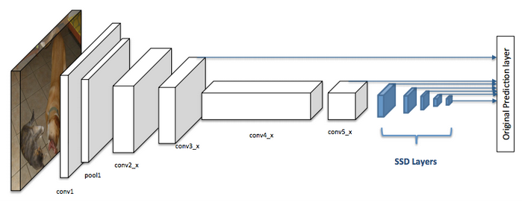
SSD – Single Shot MultiBox Detector (2/2)
We will explain what feature and feature map are later on.
The SSD head is just one or more convolutional layers added to this backbone and the outputs are interpreted as the bounding boxes and classes of objects in the spatial location of the final layers activations.
In the figure on the right, the first few layers (white boxes) are the backbone, the last few layers (blue boxes) represent the SSD head.

Slide 53
Non-Max Suppression

Slide 54
Reason for Non-Max Suppression
Typical Object detection pipeline has one component for generating proposals for classification.
Proposals are nothing but the candidate regions for the object of interest.
Most of the approaches employ a sliding window over the feature map and assigns foreground/background scores depending on the features computed in that window.
The neighborhood windows have similar scores to some extent and are considered as candidate regions.
This leads to hundreds of proposals.
As the proposal generation method should have high recall, we keep loose constraints in this stage.
However processing these many proposals all through the classification network is cumbersome.
This leads to a technique which filters the proposals based on some criteria ( which we will see soon) called Non-Maximum Suppression.

Slide 55
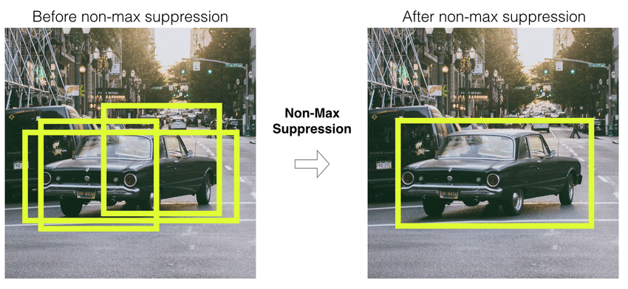
Non-Max Suppression
Non-maximum suppression (NMS) is a post-processing technique used in object detection to eliminate duplicate detections and select the most relevant detected objects.
This helps reduce false positives and the computational complexity of a detection algorithm.
Before Non-Max Suppression
Non-Max Suppression
After Non-Max Suppression

Slide 56
Non-Max Suppression Algorithm
Input: A list of Proposal boxes B, corresponding confidence scores S and overlap threshold N.
Output: A list of filtered proposals D.
Algorithm:
Select the proposal with highest confidence score, remove it from B and add it to the final proposal list D. (Initially D is empty).
Now compare this proposal with all the proposals — calculate the IoU (Intersection over Union) of this proposal with every other proposal. If the IoU is greater than the threshold T, remove that proposal from B.
Again, take the proposal with the highest confidence from the remaining proposals in B and remove it from B and add it to D.
Once again calculate the IoU of this proposal with all the proposals in B and eliminate the boxes which have high IoU than threshold.
This process is repeated until there are no more proposals left in B.

Slide 57
Non-Max Suppression Algorithm (as a While Loop)
Algorithm (continue: while loop):
While there are any redmaining boxes
Select the proposal with highest confidence score, remove it from B and add it to the final proposal list D. (Initially D is empty).
Now compare this proposal with all the proposals — calculate the IoU (Intersection over Union) of this proposal with every other proposal. If the IoU is greater than the threshold T, remove that proposal from B.
Input: A list of Proposal boxes B, corresponding confidence scores S and overlap threshold N.
Output: A list of filtered proposals D.
Algorithm (begin):
Each output prediction is
Pc
x_min
y_min
x_max
y_max
c1
c2
c3
…
cN

Slide 58
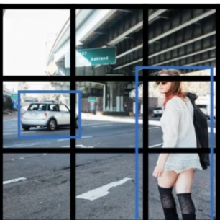
Outputting the Non-Max Suppressed Outputs
For each grid call, get 2 predicted bounding boxes.
Get rid of low probability predictions.
For each class (pedestrian, car, motorcycle, …) use non-max suppression to generate final predictions.

Slide 59
Chapter 16 – Object Localization and Detection

